Slide 1
INVESTMENTS
Week 9: Hedge Funds
Vikas Raman
Note: Some slides are based on material from Wang (2018).

Slide 2
What are Hedge Funds?
Hedge funds are investment pools that are relatively unconstrained in what they do. They are relatively unregulated (for now), charge very high fees, will not necessarily give you your money back when you want it, and will generally not tell you what they do. They are supposed to make money all the time, and when they fail at this, their investors redeem and go to someone else who has recently been making money. Every three or four years they deliver a one-in-a-hundred year flood. They are generally run for rich people in Geneva, Switzerland, by rich people in Greenwich, Connecticut.”
-Cliff Asness, Journal of Portfolio Management

Slide 3
What are Hedge Funds?
Hedge funds are one category of alternative investment funds. Alternative investment funds invest in a variety of global assets, including property and commodities, and they often have a high degree of flexibility around how they invest. Hedge funds are a type of alternative investment fund which use this freedom to pursue a wide variety of strategies in many different asset classes: some run very concentrated portfolios; others pursue complex trading strategies characterised by high levels of turnover; and others employ high levels of leverage.
- Financial Conduct Authority (UK)
(http://www.fca.org.uk/your-fca/documents/hedge-fund-survey)

Slide 4
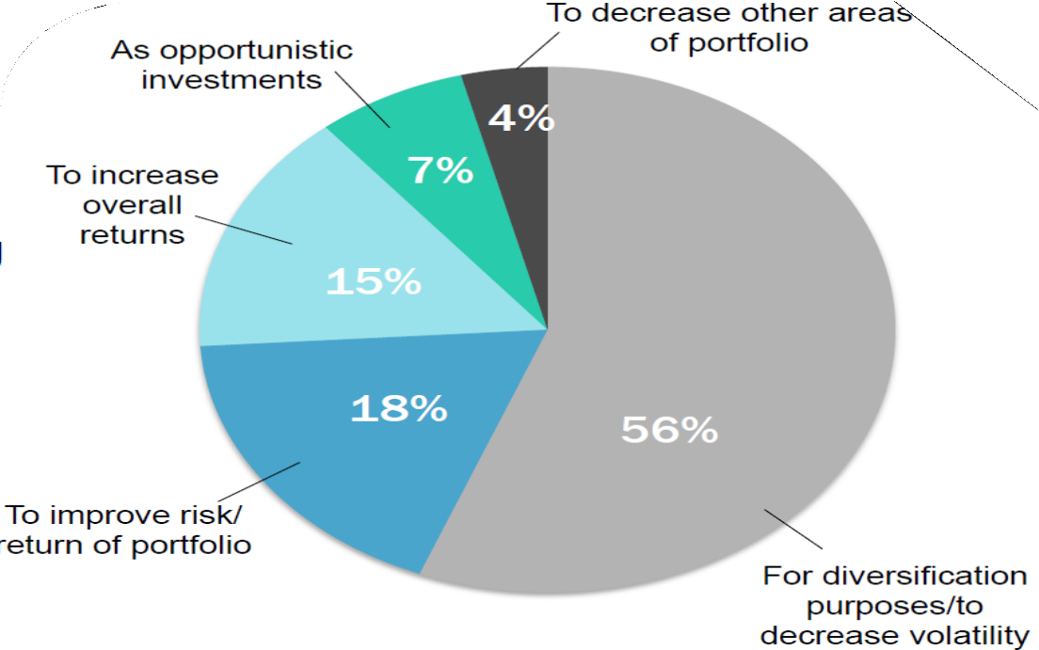
Why Invest in Hedge Funds
Morgan Stanley Survey: Primary Reason for Investing in Hedge Funds

Slide 5
Hedge Funds v/s Mutual Funds
Hedge Fund
Mutual Fund
Transparency: Limited Liability Partnerships that provide only minimal disclosure of strategy and portfolio composition
No more than 100 “sophisticated”, wealthy investors
Transparency: Regulations require public disclosure of strategy and portfolio composition
Number of investors is not limited

Slide 6
Hedge Funds v/s Mutual Funds
Hedge Fund
Mutual Fund
Investment strategy: Very flexible, funds can act opportunistically and make a wide range of investments
Often use shorting, leverage, options
Liquidity: Often have lock-up periods, require advance redemption notices
Investment strategy: Predictable, stable strategies, stated in prospectus
Limited use of shorting, leverage, options
Liquidity: Can often move more easily into and out of a mutual fund

Slide 7
Hedge Funds v/s Mutual Funds
Hedge Fund
Mutual Fund
Compensation structure: Typically charge a management fee of 1-2% of assets and an incentive fee of 20% of profits
Compensation structure: Fees are usually a fixed percentage of assets, typically 0.5% to 1.5%

Slide 8
Hedge Fund Fees
A typical fee structure for hedge funds includes both a management fee and a performance fee, whereas a typical mutual fund does not require a performance fee, and has a smaller management fee.
Hedge fund management fees are usually around 2% of net asset value (NAV).
Performance fees are approximately 20% of investment profits beyond a stipulated benchmark performance, annually.
This “2 and 20” fee structure is significantly higher than for most other money managers, with the exception of private equity fund managers, who enjoy similarly high fees.

Slide 9
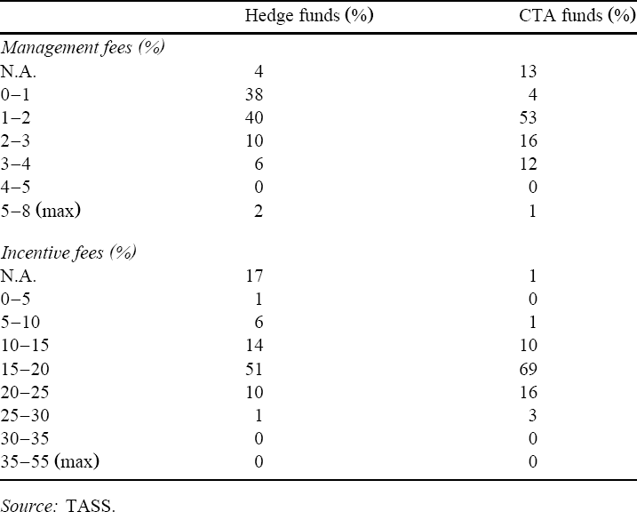
Hedge Fund Fees
Fung and Hsieh (1999)

Slide 10
Hedge Fund Fees
The calculation of investment profits for the purpose of calculating incentive fees can follow different structures:
The profit can simply be the total increase in NAV
The profit can be the increase in NAV after adjusting for management fees
Hurdle rate: funds agree to a hurdle rate whereby the fund receives a performance fee only if the fund’s annual return exceeds a benchmark rate.
High water mark: fund managers typically receive performance fees only when the value of the fund exceeds the highest net asset value it has previously achieved.
The fee structure can give incentives to shut down a poorly performing fund.

Slide 11
Hedge Fund Fees
The hurdle rate is 6% and the incentive fee is calculated on gains net of management fees. The fund began with $100 millions in assets.
Year | Beginning gross NAV | Ending gross NAV | Management Fee | Performance Fee | End value (net fees)
1 | $100 mill | $130 mill | =2%*100 | =20% of [130- | =130-2-4.4
 |  |  | =$ 2mill | 100(1+6%)-2] | =$123.6 mill
 |  |  |  | =$4.4 mill
2 | $123.6 mill | $135 mill | =2%*$123.6 | =20% of [135- | =135-2.472-
 |  |  | =$2.472 mill | 123.6(1+6%)- | 0.3024
 |  |  |  | 2.472] | =$132.225
 |  |  |  | =$0.3024 mill | mill
3 | $132.225 | $140 mill | =2%*132.225 | =20% of [140- | =140-2.644=
 | mill |  | =$2.644 mill | 132.225(1+6% | $137.356 mill
 |  |  |  | )-2.644
 |  |  |  | =$-0.56 mill

Slide 12
Hedge Fund Fees
Year | High-Water Mark | New NAV | Performance Fee (assuming 0 mgmt fee, 0 bhmk)
1 | 100 | 140 | =20% of 40=8
2 | 140 | 120 | No performance fees as the NAV is below the high- water mark
3 | 140 | 160 | =20% of 20=4

Slide 13
Hedge Fund Leverage
Hedge funds frequently borrow (creating “leverage”) in order to increase the size of their investment portfolio and increase returns (if asset values increase).
Short sell: leverage is provided by selling securities short and using the proceeds to purchase other securities.
Margin loan: if a hedge fund received $100 million from investors, the fund might by combining investor funds with $300 million from banks, using the $400 mill of purchased securities as collateral against the $300 million loan.
Repurchase agreements: a hedge fund agrees to sell a security to another party for a predetermined price and then buy the security back at a higher price on a specified date in the future.
Through derivatives contracts that enable hedge funds to create exposure to an asset without using as much capital as would be required by buying the asset directly.

Slide 14
Hedge Fund Leverage
When hedge funds borrow money, their losses, as well as their gains, are magnified.
For example, if a hedge fund receives $100 million from investors it may then borrow $300 million to make investments totaling $400 million.
A 25% fall in the value of its $400 million investment portfolio would result in a total loss of the investor’s capital if the hedge fund closed down.
If, alternatively, the investment portfolio increased by 25%, investors would receive a 100% return on their investment, before subtracting management fees and operating costs.
During the 2008 Financial Crisis, leverage made available to hedge funds dropped precipitously.

Slide 15
Hedge Fund Strategies
Directional
Bets that one sector or another will outperform other sectors
Non-directional
Exploit temporary misalignments in relative valuation across sectors
Buy one type of security and sell another
Strives to be market neutral

Slide 16
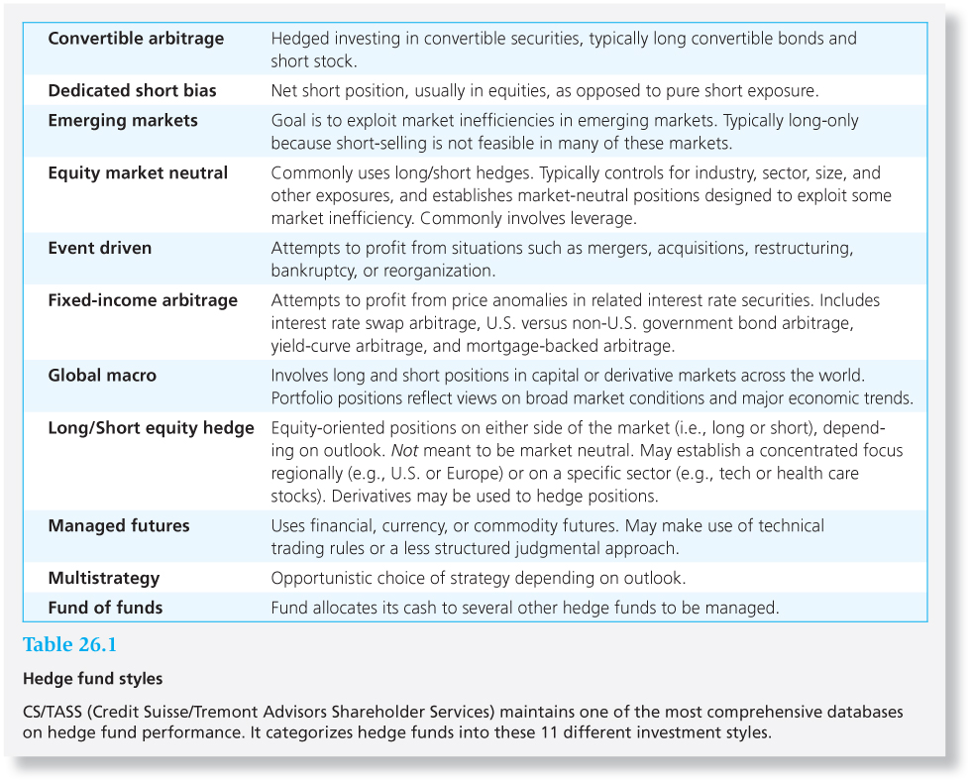
Hedge Fund Strategies

Slide 17
Hedge Fund Strategies
Hedge Fund Strategies
Equity
Macro
Arbitrage
Long-Short
Global Macro
Event Driven
Market Neutral
Managed Futures
Convertible
Short Bias
Emerging Mkts
Fixed Income
Mixed Strategies

Slide 18
Performance of Hedge Funds
Market-neutral funds have insignificant betas.
Dedicated short bias funds exhibit substantial negative betas on the S&P index.
Distressed firm funds have significant exposure to credit conditions.
Global macro funds show negative exposure to a stronger U.S. dollar.

Slide 19
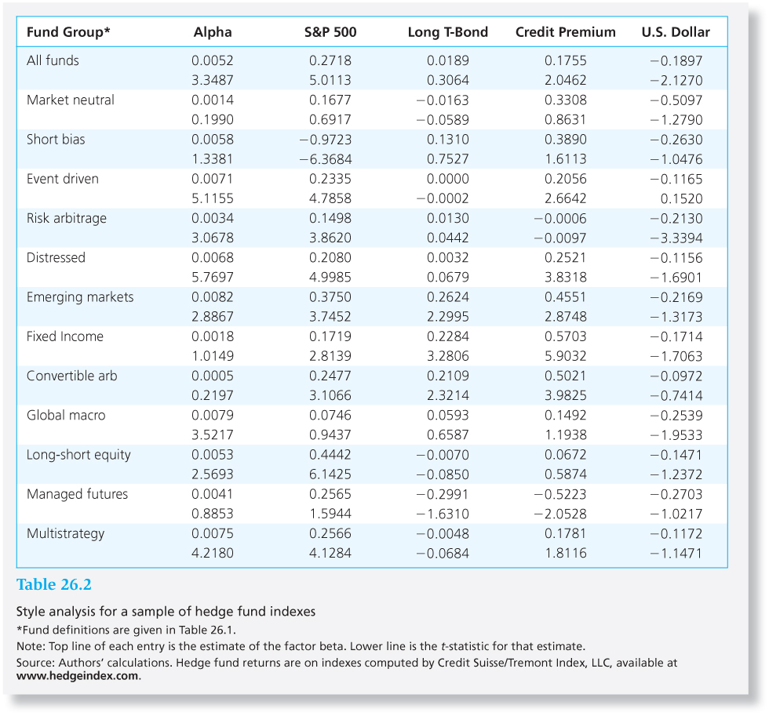
Performance of Hedge Funds
Market-neutral funds have insignificant betas.
Dedicated short bias funds exhibit substantial negative betas on the S&P index.
Distressed firm funds have significant exposure to credit conditions.
Global macro funds show negative exposure to a stronger U.S. dollar.

Slide 20
Alphas: Compensation for Illiquidity?
Hedge funds tend to hold more illiquid assets than other institutional investors.
Aragon: Typical alpha may actually be an equilibrium liquidity premium rather than a sign of stock-picking ability.
Hasanhodzic and Lo: Hedge fund returns have serial correlation, a sign of liquidity problems. This biases the Sharpe ratios upward.

Slide 21
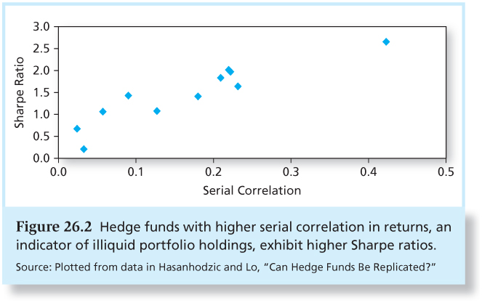
Alphas: Compensation for Illiquidity?

Slide 22
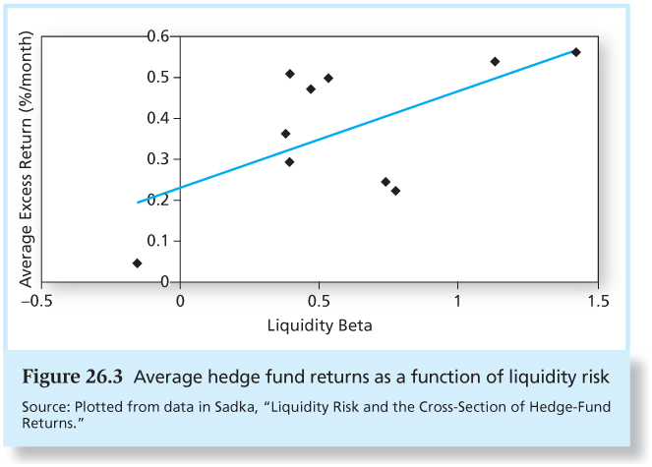
Alphas: Compensation for Illiquidity?
Sadka: Unexpected declines in market liquidity are an important determinant of average hedge fund returns.

Slide 23
Hedge Fund Performance and Survivorship Bias
Backfill bias:
Hedge funds report returns only if they choose to and they may do so only when their prior performance is good.
Survivorship bias:
Failed funds drop out of the database
Hedge fund attrition rates are more than double those for mutual funds.

Slide 24
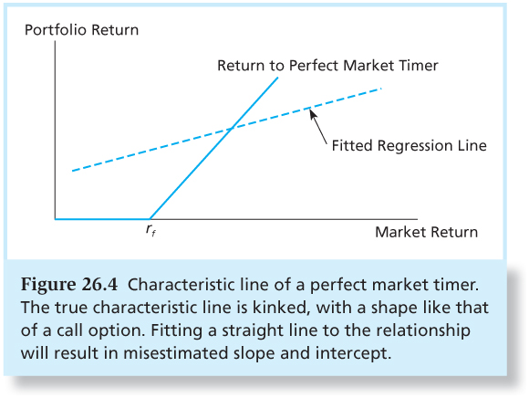
Hedge Fund Performance and Changing Factor Loadings
Hedge funds are designed to be opportunistic and may frequently change their risk profiles.
If risk is not constant, alphas will be biased if a standard, linear index model is used.

Slide 25
Fund of Funds
Funds that invest in one or more other hedge funds. Also called “feeder funds”.
A way to diversify across many hedge funds.
Supposed to provide due diligence in screening funds for investment worthiness.
Madoff scandal showed that these advantages are not always realized in practice.

Slide 26
Fund of Funds
Optionality can have a big impact on expected fees.
Fund of funds pays an incentive fee to each underlying fund that outperforms its benchmark even if the aggregate performance is poor.
Investors need to be aware that these funds of funds operate with considerable leverage.
If the various hedge funds in which these funds of funds invest have similar investment styles, diversification may be illusory.

Slide 27
Fund of Funds
 | Fund 1 | Fund 2 | Fund 3 | Fund of Funds
Start of year (millions) | $1.00 | $1.00 | $1.00 | $3.00
End of year (millions) | $1.20 | $1.40 | $0.25 | $2.85
Gross rate of return | 20% | 40% | -75% | -5%
Incentive fee (millions) | $0.04 | $0.08 | $0.00 | $0.12
End of year, net of fee | $1.16 | $1.32 | $.25 | $2.73
Net rate of return | 16% | 32% | -75% | -9%

Slide 28
Fund of Funds
A fund of funds has $1 million invested in three hedge funds
Hurdle rate for the incentive fee is a zero return
Each fund charges an incentive fee of 20%
The aggregate portfolio of the fund of funds is -5%
Still pays incentive fees of $.12 for every $3 invested

